Slide 1
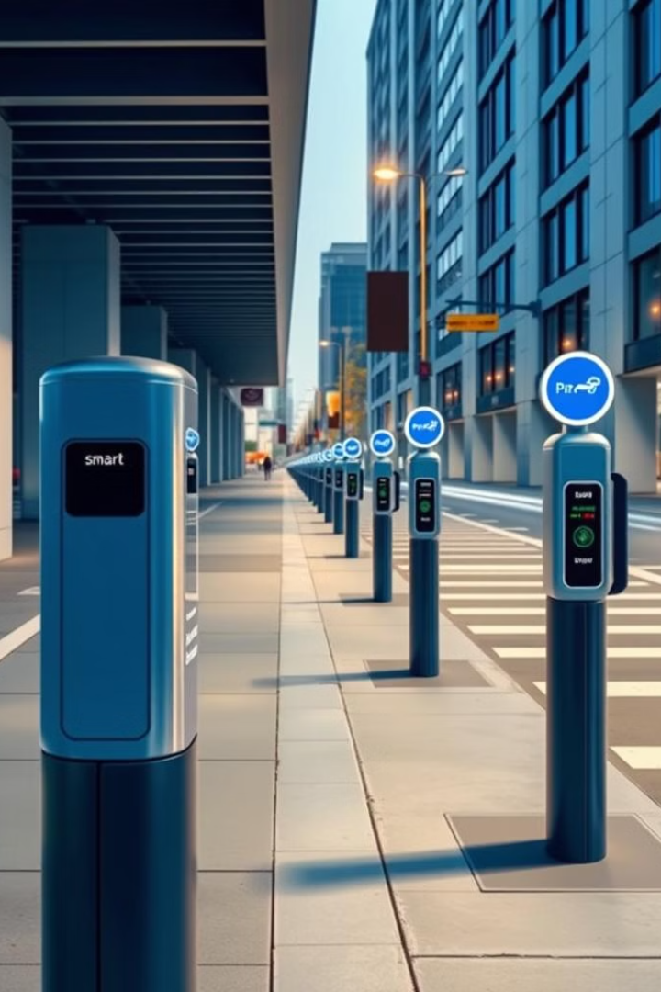
Smart Parking System using Arduino
This smart parking system leverages the power of Arduino to revolutionize the way drivers find and pay for parking. By integrating sensors, vehicle tracking, it provides a seamless, efficient, and data-driven parking experience.

Slide 2
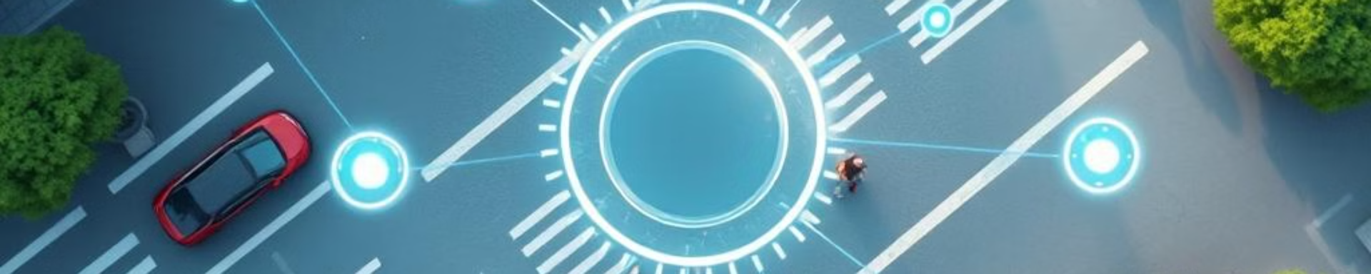
Introduction to Smart Parking
1
Efficient Parking Management
2
Data-Driven Insights
The system collects valuable data on parking usage patterns, enabling city planners to optimize infrastructure and policies.
The system monitors available parking spots in real-time, guiding drivers to open spaces and reducing search time.

Slide 3
How the System Works
Explains the basic functioning of the Smart Parking System using Arduino and the interaction between various components.
Here’s how you can explain this slide in detail:
Ultrasonic Sensors Detect Availability:
Function: Ultrasonic sensors are placed in each parking space to detect whether the spot is occupied or vacant. The sensor emits ultrasonic waves, and based on the time it takes for the waves to reflect back, the system calculates the distance to the nearest object (e.g., a car).
Data Sent to Arduino:
The ultrasonic sensors continuously send data to the Arduino board. The Arduino processes this information in real time, determining the status of each parking space (occupied or free).
Processing of Sensor Data:
The Arduino microcontroller reads the input from the ultrasonic sensors and uses predefined logic (such as distance thresholds) to decide whether a parking spot is vacant or occupied. In the code example:
Servo Motor or Buzzer Indications (Optional):
In the code example, if a car is detected, the servo motor (acting like a gate) moves to open or close based on the detection.
Real-Time System Updates:
The system updates continuously as the ultrasonic sensors monitor the parking spaces in real-time. Whenever a car enters or leaves, the system adjusts the parking status and updates the display.

Slide 4
Arduino Hardware and Software
Arduino Uno
Arduino IDE
Programming Language
The heart of the system is an Arduino Uno, a powerful and flexible microcontroller board that can interface with various sensors and actuators.
The Arduino Integrated Development Environment (IDE) is used to write, compile, and upload the control software to the board.
The Arduino platform supports the c/c++ programming language, allowing developers to create custom firmware for the parking system.

Slide 5
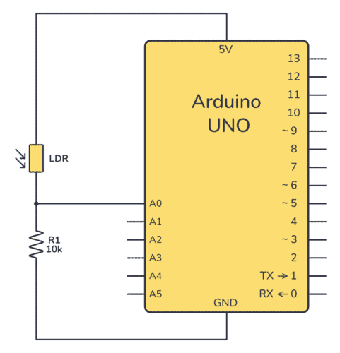
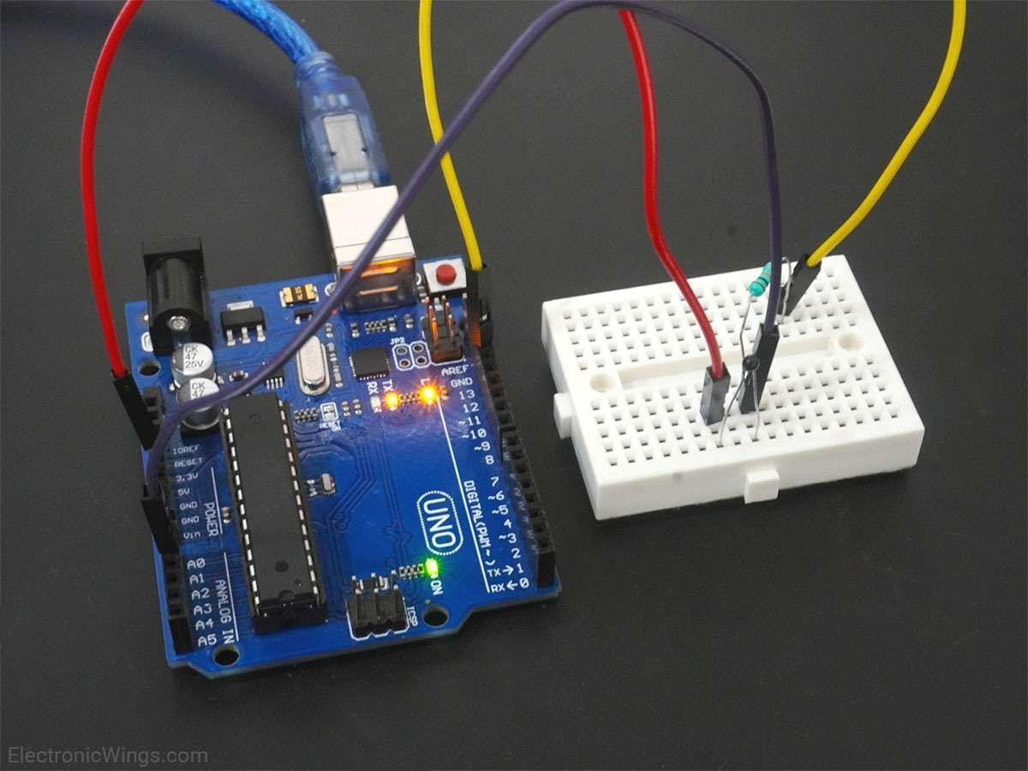
Circuit Diagram
Basic schematic of how the components are connected.
Key connections between sensors and Arduino.

Slide 6
Code Overview
#include <Servo.h>
Servo myservo;
int pos = 0;
int cm = 0;
long readUltrasonicDistance(int triggerPin, int echoPin){
pinMode(triggerPin, OUTPUT);
digitalWrite(triggerPin, LOW);
delayMicroseconds(2);
digitalWrite(triggerPin, HIGH);
delayMicroseconds(10);
digitalWrite(triggerPin, LOW);
pinMode(echoPin, INPUT);
return pulseIn(echoPin, HIGH);
}void setup()
{
digitalWrite(12,LOW);
myservo.attach(9);
Serial.begin(9600);
}void loop() {
cm = 0.01723 * readUltrasonicDistance(6, 7);
if(cm<30){
Serial.print(cm);
Serial.println("cm");
for (pos = 0; pos <= 120; pos += 1) {
myservo.write(pos);
delay(15);
} delay(500);
for (pos = 120; pos >= 0; pos -= 1)
{
myservo.write(pos);
delay(15);
}
delay(5000);
//add delay how much you want
}
}

Slide 7
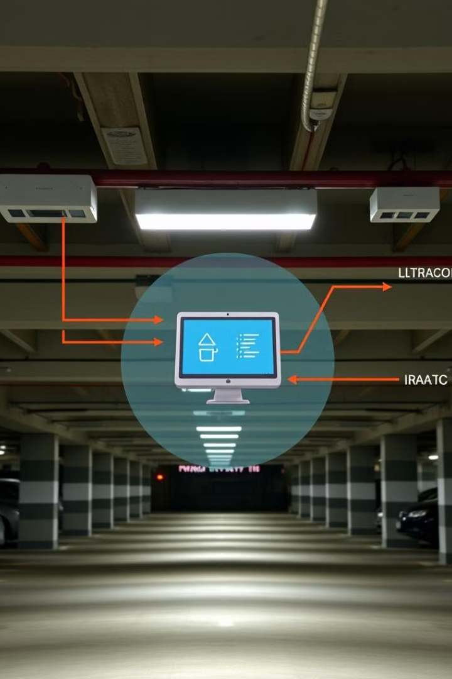
Integration
1
Ultrasonic Sensors
Detect the presence of vehicles in parking spots, providing real-time occupancy data.
2
Servo Motor
A servo motor is a rotary or linear actuator designed for precise control of angular or linear position, speed, and acceleration.
3
Arduino
It consists of microcontroller boards that can be programmed to control various electronic devices and sensors

Slide 8

Parking Slot Detection
Vacant Spot Identification
Dynamic Mapping
A digital map of the parking area is generated, with real-time updates on available and occupied spots displayed to users.
The system uses sensor data to continuously monitor the occupancy status of each parking spot, identifying open spaces for drivers.
Adaptive Guidance
The system provides turn-by-turn directions to the nearest available parking spot, optimizing the driver's parking experience.

Slide 9
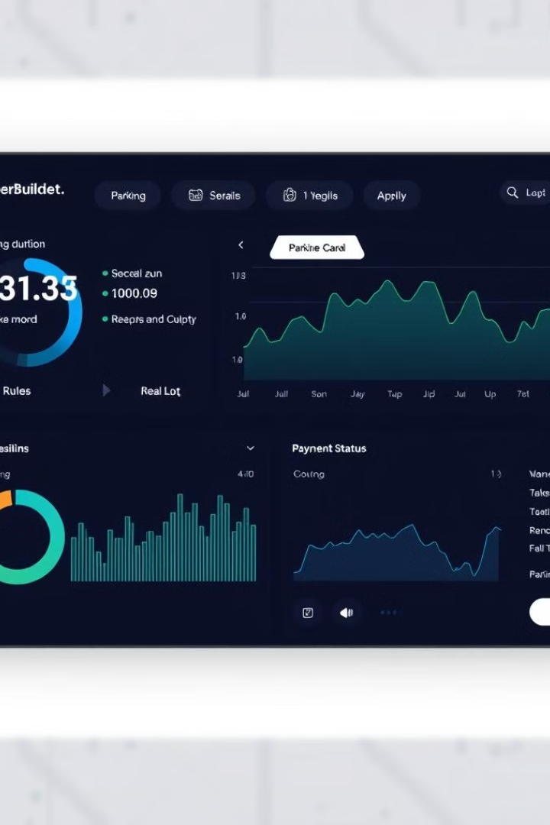



Vehicle Tracking and Monitoring
Vehicle Entry
Sensors at the entrance detect vehicles and initiate the tracking process.
Occupancy Monitoring
The system continuously tracks the location and duration of each vehicle in the parking area.
Vehicle Exit
Sensors at the exit record the vehicle's departure and stop the payment process.

Slide 10
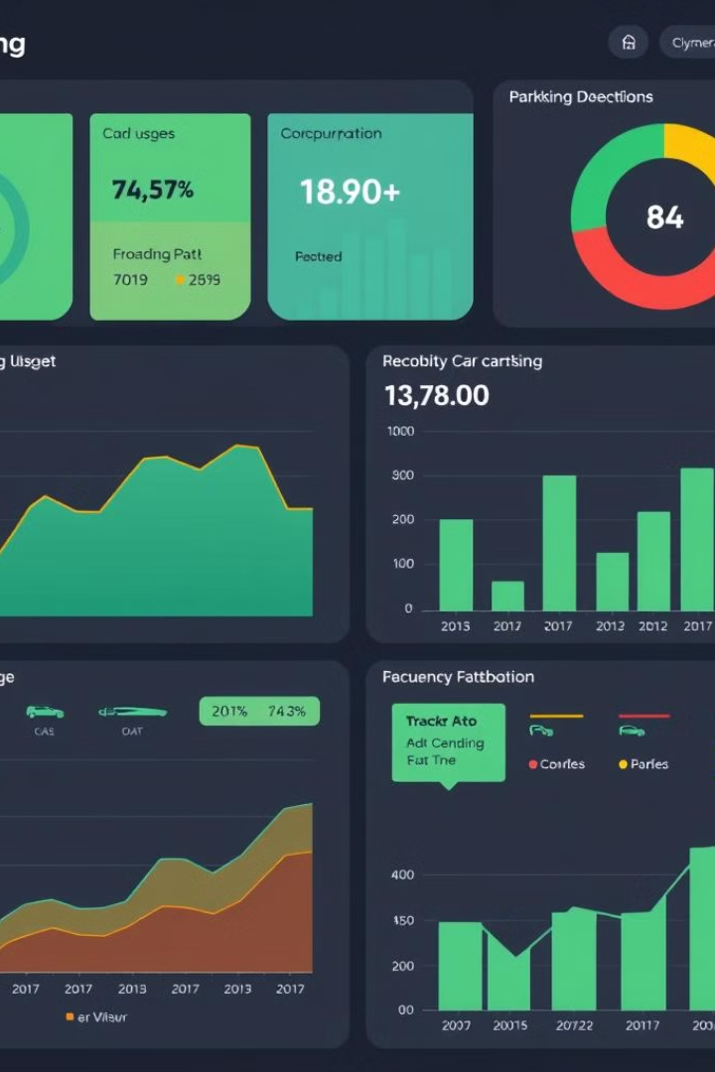
Data Analytics and Reporting
Occupancy Rates
Real-time data on parking spot utilization, identifying peak and off-peak times.
Revenue Tracking
Detailed reporting on parking fees collected, enabling efficient management and optimization.
Trend Analysis
Historical data provides insights into parking demand patterns, supporting infrastructure planning.

Slide 11

Benefits and Future Developments
1
Improved Driver Experience
2
Optimized Infrastructure
The smart parking system enhances convenience, reduces search time, and eliminates the hassle of finding and paying for parking.
Data-driven insights enable city planners to make informed decisions about parking capacity, pricing, and regulations.
3
Future Integrations
The system can be further enhanced with features like automated parking, electric vehicle charging, and integration with autonomous vehicles.

Slide 12
Thank you

